Slide 1


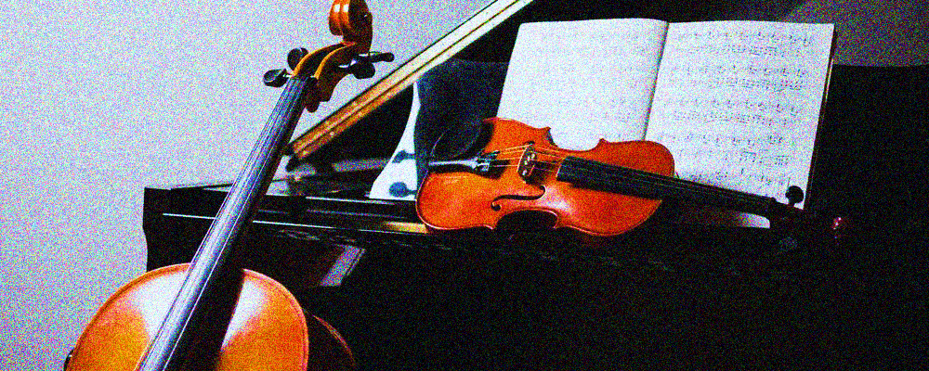
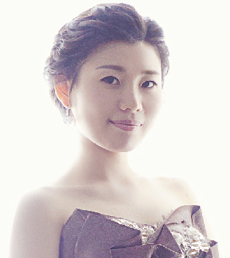
Ecole Music Sydney Team Information
Ecole Music Sydney Team
Piano
Juliana Seo | Head of School (Piano | Theory | Accompaniment)
Juliana began his studies in piano at the age of 3. By the age of 10, she received the Grand Prize from Korea Art Promotion Association, a prestigious art association in S. Korea. After competing her Bachelor of Music from a top-tier music university in S. Korean and her post graduate
degrees from world class music institutions in Germany and France, she was appointed as an adjunct faculty in a Korean prestigious music university and has worked as Int’l concert pianist.
Education
École Normale de Musique de Paris, France - Diplôme Supérieur d’Enseignement (Supreme Post Grad. Education Diploma) - Diplôme Supérieur d’Exécution (Supreme Post Grad. Solo Performing Diploma)
Hanover Univ. of Music, Drama and Media, Germany (Master of Music)
Ewha Womans University, S. Korea (Bachelor of Music)
Sun Hwa Arts Highschool, S. Korea
Experience
Head of School, Ecole Music Sydney / Int’l Pianist / Member, French Music Research Society
Adjunct faculty, Chugye Univ. for the Arts - College of Music, S Korea
Music teacher, Sun Hwa Arts Highschool, S. Korea
Int'l Competition Award
1st Prize of Young Musicians Int’l Competition “Citta di Barletta” in Italy
1st Prize of Concorso Int’l di Ececuzione Musicale ‘Valeria Martina’ “Citta di Massafra” in Italy
2nd Prize of Concours Int’l de Piano ‘Madelene de Valmalte’ in Paris, France
3rd Prize of Grand Prix Int’l et Rencontre Jeunes Talents Monrond-les-Bains in France
About Ecole Music Sydney
Ecole Music Sydney was founded in 2017 and has provided high standards of music education for a wide range of instruments. Our systemized teaching methods will inspire and motivate our students, and help them achieve their best.

Slide 2
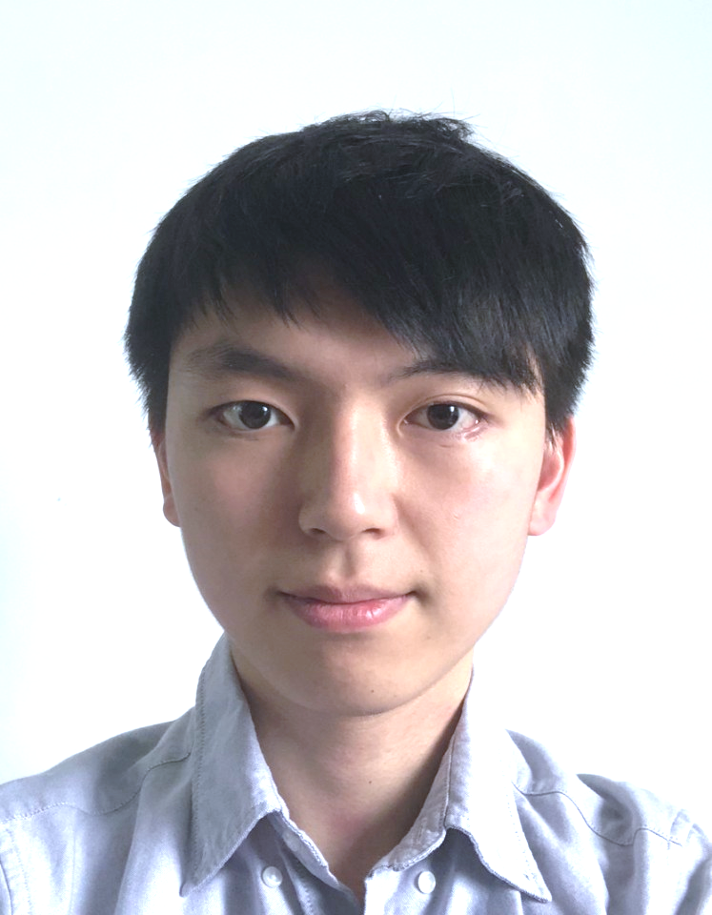
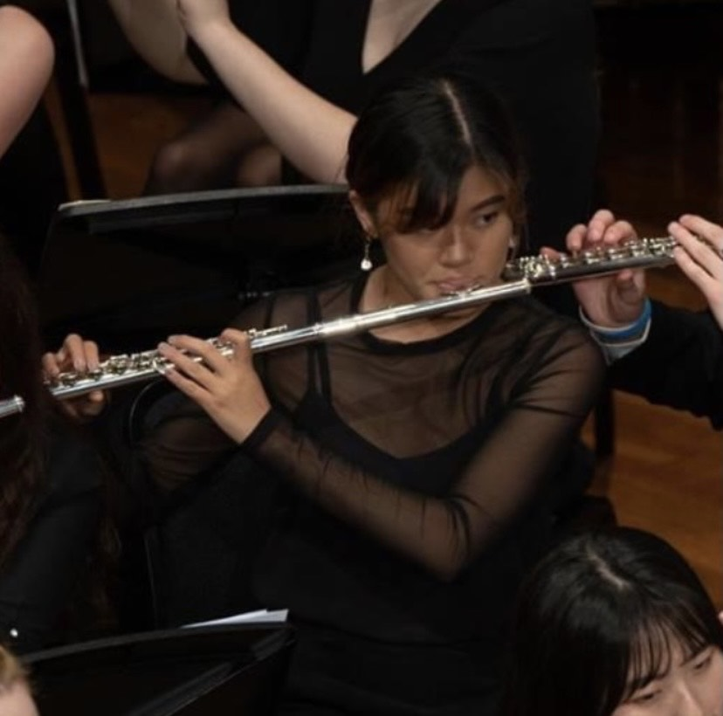
Ecole Music Sydney Team Information
Piano
Jay Cho | Piano Teacher (Piano | Theory | Accompaniment)
With wider teaching experience in the public school, school holiday programs, private tutoring, etc, Jay is a dedicated, patient, and compassionate music educator. Having graduated from Knox Grammar School with top ATAR, he has made diverse academic achievements.
His patience and expertise in music education has allowed students to be successful in acquiring great result in both performance and exams and aims to nurture students to develop a strong interest in the instrument.
Education
Sydney Conservatorium of Music, Bachelor of Music (Music Education) / AMusA
- A recipient of Clarence Addison Turrill Scholarship
Knox Grammar School, Wahroonga (Graduated with the top ATAR of 95.05) - Music 2 and Music Extension with the highest mark (Band 6)
Experience
Teaching experience in Turramurra Public School, school holiday programs of upper north shore suburbs (St Ives, Linfield, Pymble and more), etc.
Music activities in Symphonic Wind Ensemble and Knox Symphony Orchestra
Active volunteer of local Christian community groups
Flute / Piano
Amy Sung | Piano & Flute Teacher (Flute | Piano | Theory )
With 13 years experience in various ensembles including Hunter Wind Ensemble, Newcastle Conservatorium Concert Band, Sydney University Wind Orchestra and Sydney Conservatorium Flute Ensemble, Amy Sung is a holistic and professional flutist/educator. Based on a heavy focus on the nurturing aspect of music, she has taught a wide range of flute students from
beginner to advanced level: Primary School and High School classes as a Pre-Service Music Teacher. She is always looking forward to sharing her love for learning and teaching music and to inspire her students to keep learning and playing music with the same enjoyment that she has.
Education
Bachelor of Music (Music Education) at Sydney Conservatorium of Music (3rd year)
AMEB Certificate of Performance (CMUSA)
HSC Music 1 with Band 6 at Maitland Grossmann High School
Experience
Theatre Scholarship at Newcastle Conservatorium of Music
Completed Pex1 and Pex 2 (Practical Experience) in Primary and High School settings
Travelled to Spain and Portugal on tour with Hunter Wind Ensemble
Taught flute in various settings including 1 on 1, groups, and ensembles
Travelled to Spain and Portugal on tour with Hunter Wind Ensemble

Slide 3
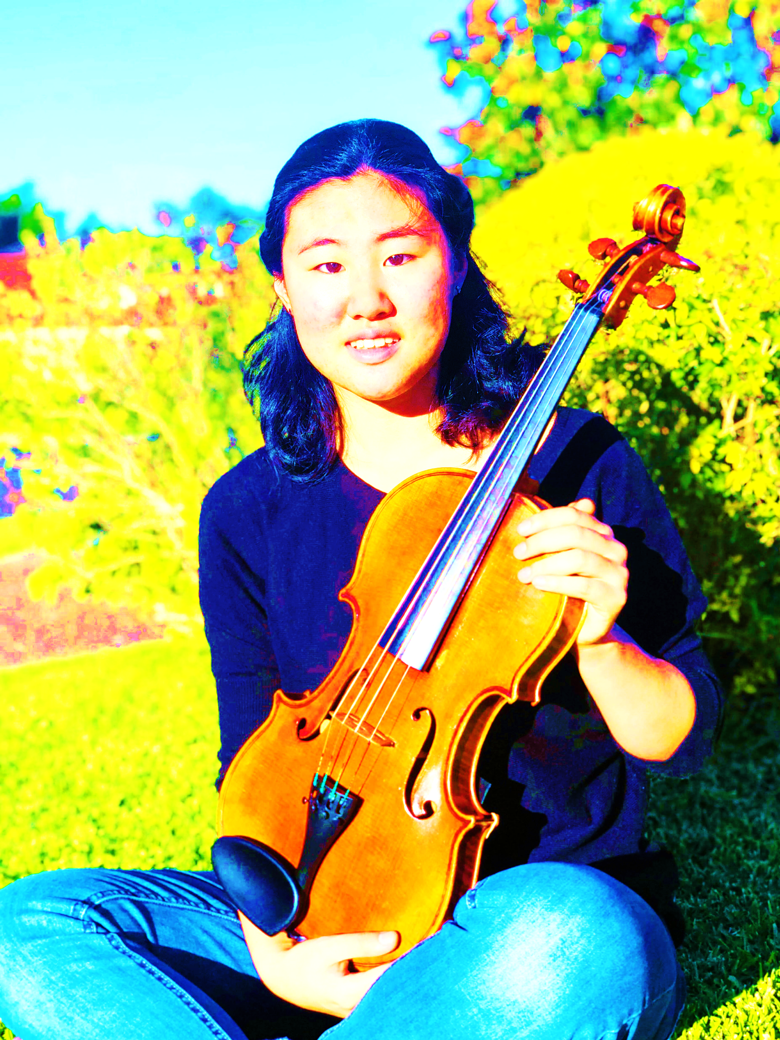
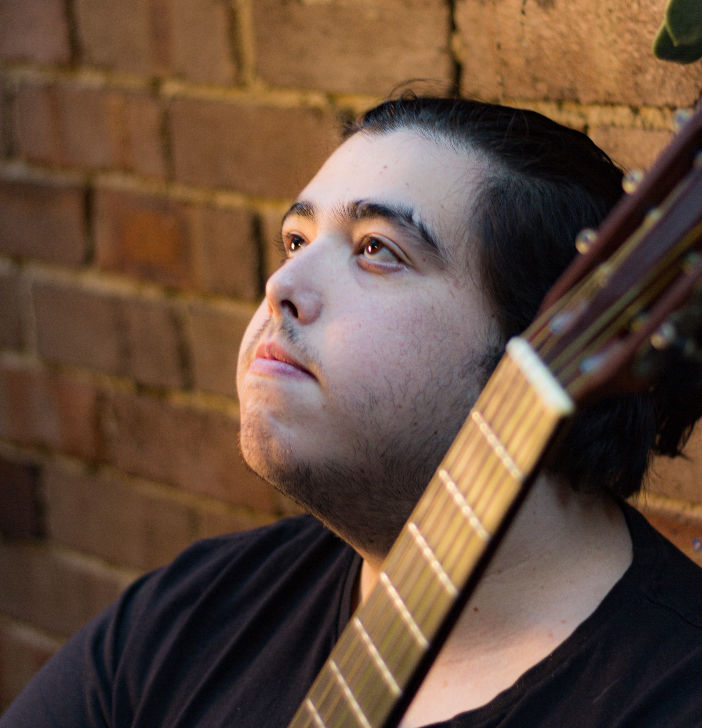
Ecole Music Sydney Team Information
Violin /
Clarinet
Suzie Kim | Violin & Clarinet Teacher (Violin | Viola | Clarinet )
With extensive orchestral experience in violin, viola, & clarinet, Suzie Kim is an active musician as well as a dedicated teacher who is passionate in teaching music to young kids. Being involved with the Central Coast Youth Orchestra for 7 years, she has accumulated substantial orchestra experience and now is working as a mentor for the Orchestra.
And she also was involved in playing with the Symphony Central Coast and the Reginal Youth Orchestra for 2 years and experienced professional orchestra music such as the Australian Opera and Ballet Orchestra and the Australian World Orchestra. Furthermore, she has been involved in chamber ensembles (quartets, chamber orchestras) and pit orchestras (musicals and operas).
Her teaching philosophy with extensive performance experience is to instill a love of music to students by making it enjoyable through ease of playing, whilst at the same time keeping a firm hold on technique so the student is capable of achieving their best. Her warm-hearted personality and patience for young children, with her substantial orchestral experience, allow her students to perform well in exams and performances.
Education
Univ. of Sydney, Bachelor of Education (Performance major: Viola)
- AMEB Grade 8 (Violin), Music 2 + Extension & HSC (Music X Elective - Performance: Viola & Clarinet)
Experience
Scholarships & Competition - Pearl Beach Scholarship Competition Finalist (Viola), Central Coast Conservatorium Talent Development Scholarship (String), Bouddi Woodwind Scholarship Finalist (Clarinet)
Music tutor at String Summer School, Central Coast Conservatorium and diverse pedagogy experience from child beginners to intermediate adults
Guitar
Jonanthan Moran | Classical Guitar Teacher (Guitar | Theory)
With several years of combined experience playing guitar and teaching students from all ages groups, Jonathan Moran is a talented musician as well as a professional educator. Having an AMEB grade 8 performance equivalent, he has had extensive guitar performance.
He understands the important of holistic education in music, is passionate about providing value to student musicians, and is innately driven by creativity within all things musical.
His main goals for teaching is to communicate effectively with students and parents in order to cater lessons to each students pace/needs.
Education
Bachelor of Music & Computer Science, UNSW
Experience
Have experienced teaching in all musical environments including - tertiary, secondary, primary and private settings – with a specialisation in AMEB, school exams, and the performance techniques.
Music tutor at Cumberland high school and a private music institution.

